Slide 1
R Shiny Web App Development
Building Interactive Web Apps with R
Sayali Salunkhe

Slide 2


Slide 3
What is R shiny?
Overview of R shiny as a web application framework
Benefits of R Shiny for web app development
Examples of interactive visualizations and data-driven applications
Notes:
Point 3 mention increase usage of data driven microsites. So as you know data tells a story.For example New york times. They are doing really good job of putting data into their applications.

Slide 4
Notes:
As you can see shiny app allows user to log in and start to select various parameters of machine learning model and builds model in front of them.User can see the results, they can see predictions. They can see how it changes. What you are seeing on screen is great example of how we can take models and bring it into the user experience.

Slide 5
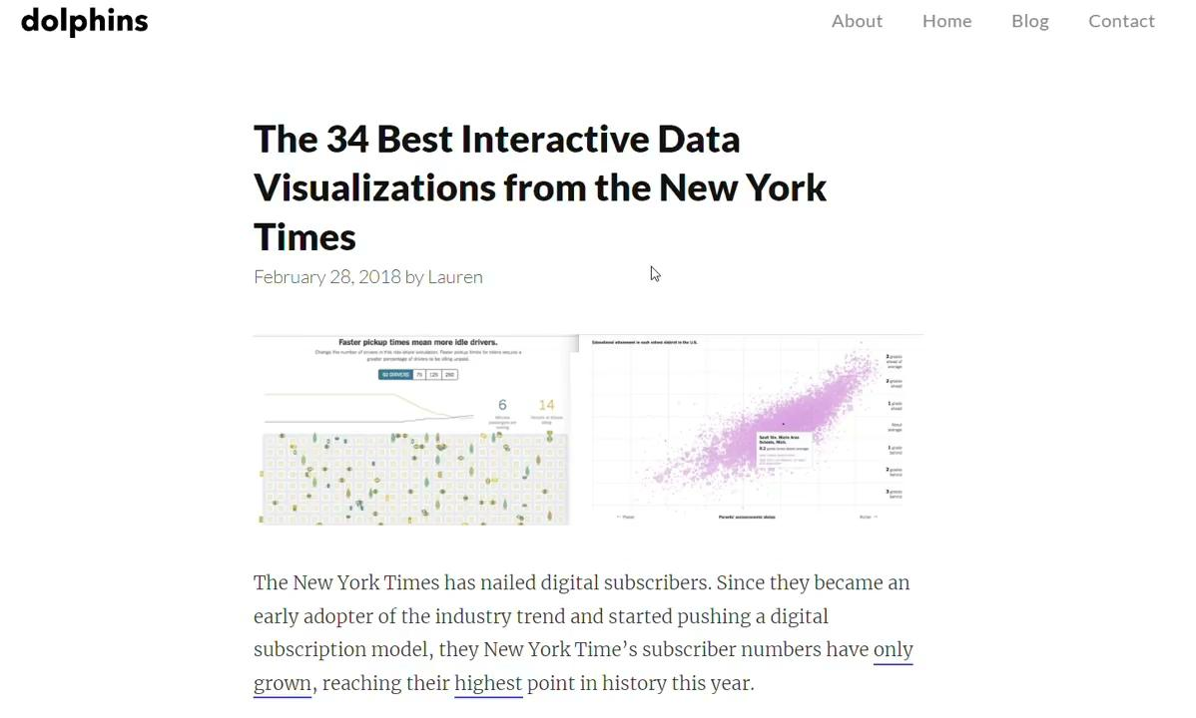
Notes:
I am adding link of this article in chatbox https://getdolphins.com/blog/interactive-data-visualizations-new-york-times/ . New York Times is relied on R shiny and R to get these prototype and show their users. https://blog.revolutionanalytics.com/2011/03/how-the-new-york-times-uses-r-for-data-visualization.html blog link

Slide 6
Key Features and Functionality
Reactive programming model for automatic updates
Wide range of input widgets for user interactions
Dynamic output generation based on user inputs
Integration of statistical models and data manipulation

Slide 7
Conclusion and Resources
Recap of the key points discussed
Explore R Shiny for app development
Resources for learning and further exploration
Notes:
Point 2: Encouragement Point 3: Resources for learning and further exploration (e.g., official Shiny website, online tutorials, community forums) copy and paste this link https://shiny.posit.co/r/gallery/ 2.https://youtube.com/playlist?list=PL6wLL_RojB5xNOhe2OTSd-DPkMLVY9DfB

Slide 8
Thank You

Slide 9
UI and Server
Sayali 5/2023

Slide 10
UI
selectInput( inputId = “select”v) >>>>> input$select
numericInput( inputId = “numeric”) >>>>> input$numeric
dateinput(inputId = “date”) >>>>>> input$date
checkboxInput( inputId = “check_box”) >>>> input$check_box

Slide 11
server
output$text <- renderText(...) >>> verbatimTextOutput( “text” ) or textOutput( “text”)
output$plot <- renderPlot(...) >>>> plotOutput(“plot”)
output$table <- renderTable(...) >>>> plotTable(“table”)

